Slide 1
Decision Support and Business Intelligence Systems (9th Ed., Prentice Hall)
Chapter 14:
Management Support Systems: Emerging Trends and Impacts

Slide 2
Learning Objectives
Explore some of the emerging technologies that may impact MSS
Know how RFID data analysis can help improve supply-chain management and other operations
Describe how massive data acquisition techniques can enable reality mining
Describe how virtual-world technologies can be used for decision support
Describe how virtual-world applications can result in additional data for BI applications
Describe the potential of cloud computing in business intelligence

Slide 3
Learning Objectives
Understand social networking concepts, selected applications, and their relationship to BI
Describe organizational impacts of MSS
Learn the potential impacts of MSS on individuals
Describe societal impacts of MSS

Slide 4
RFID and BI
Wal-Mart's RFID mandate in June 2003
DoD, Target, Albertson's, Best Buy,…
RFID is a generic technology that refers to the use of radio frequency waves to identify objects
RFID is a new member of the automatic identification technologies family, which also include the ubiquitous barcodes and magnetic strips

Slide 5
How does RFID work?
RFID system –
a tag (an electronic chip attached to the product to be identified)
an interrogator (i.e., reader) with one or more antennae attached
a computer (to manage the reader and store the data captured by the reader)
Tags –
Active tag versus Passive tags

Slide 6
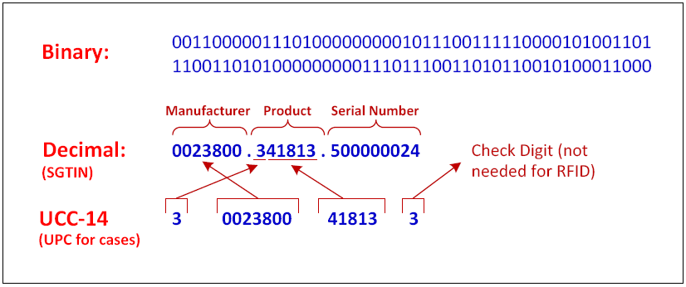
Data Representation for RFID
RFID tags contain 96 bits of data in the form of serialized global trade identification numbers (SGTIN) [see epcglobalinc.org]

Slide 7
RFID for Supply Chain BI
RFID in Retail Systems
Functions in a distribution center
receiving, put-away, picking, and shipping
Sequence of operations at a receiving duck
unloading the contents of the trailer
verification of the receipt of goods against expected delivery (purchase order)
documentation of the discrepancy
application of labels to the pallets, cases, items
sorting of goods for put-away or cross-dock

Slide 8
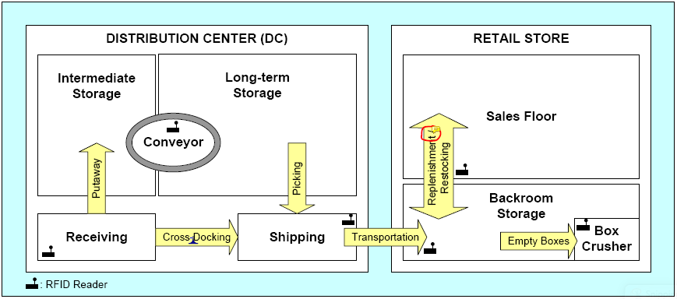
RFID for Supply Chain BI
RFID in Retail Systems

Slide 9
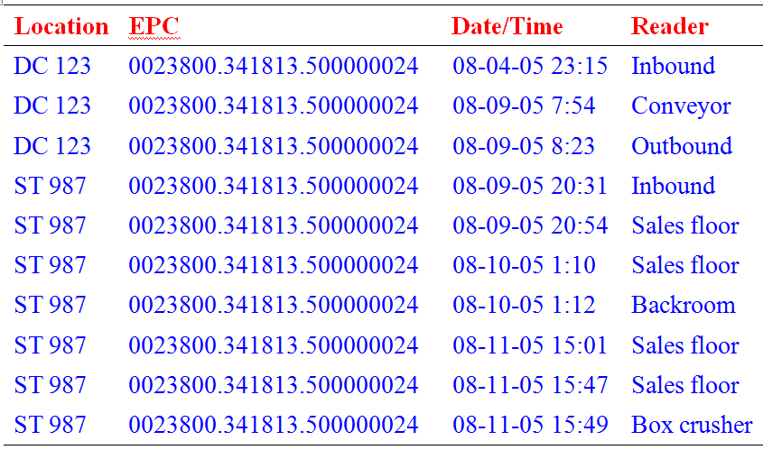
RFID Data Sample
RFID in Retail Systems

Slide 10
RFID for BI in Supply Chain
Better SC visibility with RFID systems
Timing/duration of movements between different locations – especially important for products with limited shelf life
Better management of out-of-stock items (optimal restocking of store shelves)
Help streamline the backroom operations: eliminate unnecessary case cycles, reorders
Better analysis of movement timings for more effective and efficient logistics

Slide 11
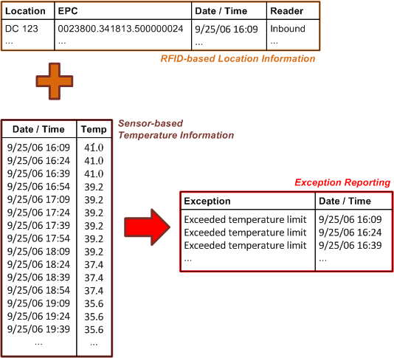
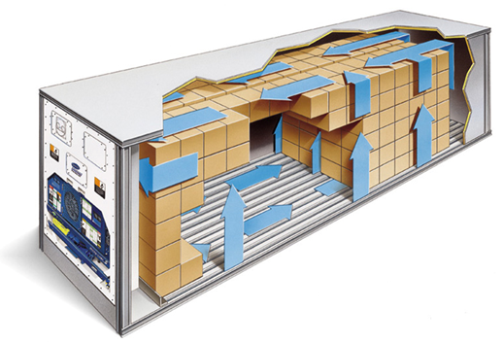
RFID + Sensors for Better BI
Knowing the location and health of goods (i.e., exception) during transportation

Slide 12
Reality Mining
Identifying aggregate patterns of human activity trends (see sensenetworks.com by MIT and Columbia University)
Many devices send location information
Cars, buses, taxis, mobile phones, cameras, and personal navigation devices
Using technologies such as GPS, WiFi, and cell tower triangulation
Enables tracking of assets, finding nearby services, locating friends/family members, …

Slide 13
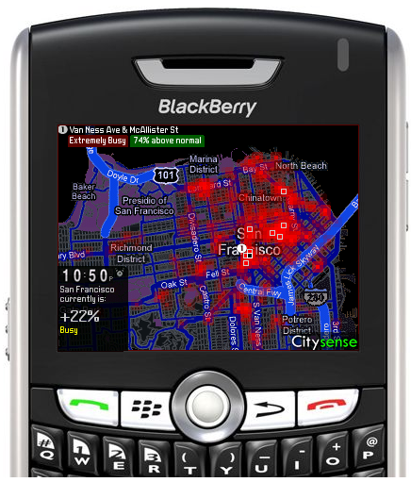
Reality Mining
Citisense: finding people with similar interests
A map of an area of San Francisco with density designation at place of interests
See www.sensenetworks.com/citysense.php for real-time animation of the content

Slide 14
Virtual Worlds
Virtual worlds have existed for a long time in various forms - stereoscopes, Cinerama, simulators, computer games, …
They are artificial worlds created by computer systems in which the user has the impression of being immersed
Examples:
Second Life (secondlife.com)
Google Lively (lively.com)
EverQuest (everquest.com)
Avatars ?

Slide 15

Stereograms

Slide 16
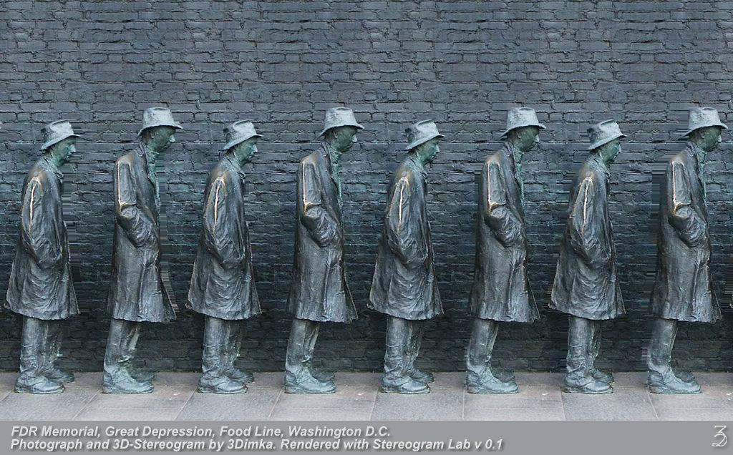
Stereograms

Slide 17
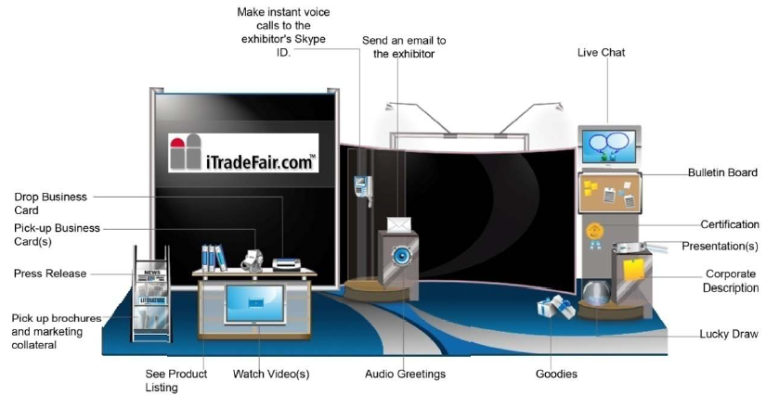
Virtual Tradeshows
See iTradeFair.com

Slide 18
Virtual (Internet) Communities
A group of people with common interests who interact with one another over a computer network, mainly the Internet
Similar to typical physical communities, such as neighborhoods, clubs, or associations, but people do not meet face-to-face
It is a social network organized around a common interest, idea, task, or goal
Members interact across time, geographic location, and organizational boundaries

Slide 19
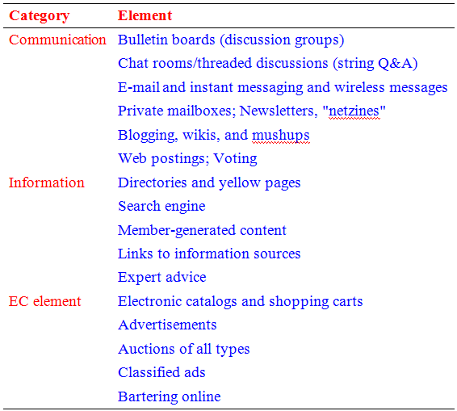
Virtual (Internet) Communities Elements of Interaction

Slide 20
Virtual (Internet) Communities Types of Virtual Communities
Transaction and other business activities
Buying/selling – ausfish.com.au
Purpose or interest
Exchange of information – fool.com, mp3.com
Relations or practices
ivillage.com, seniornet.com, isworld.com
Fantasy (e.g., espn.com)
Social networks (e.g., myspace.com)
Virtual worlds (e.g., Secondlife.com)

Slide 21
Virtual (Internet) Communities Types of Virtual Communities
Public Versus Private Communities
Membership being open or close others
Public: MySpace and Facebook
Private: IBM's Virtual Universe Community
Internal and External Private Communities
Internal: limited to employees, retirees, suppliers, and customers (e.g., Pfizer, FedEx, IBM, …)
External: also include business partners (e.g., Sony PlayStation 3 videogame network)
There are other classifications of based on the classification of members

Slide 22
Online Social Networking – Basics and Examples
A social network is a place where people create their own space, or homepage, on which they write blogs; post pictures, videos, or music; share ideas; and link to other Web locations they find interesting
The mass adoption of social networking Web sites points to an evolution in human social interaction
The size of social network sites are growing rapidly, with some having over 100 million members – growth for successful ones 40 to 50 % in the first few years and 15 to 25 % thereafter

Slide 23
Online Social Networking – Social Network Analysis Software
It is used to identify, represent, analyze, visualize, or simulate networks with
Nodes – agents, organizations, or knowledge
Edges – relationships identified from various types of input data (relational and non-relational)
Various input and output file formats exist
SNA software tools include
Business-oriented social network tools such as InFlow and NetMiner
Social Networks Visualizer, or SocNetV, which is a Linux-based open source package

Slide 24
Mobile Social Networking
Social networking where members converse and connect with one another using cell phones or other mobile devices
MySpace and Facebook offer mobile services
Mobile only services: Brightkite, and Fon11
Basic types of mobile social networks
Partnership with mobile carriers (use of MySpace over AT&T network)
Without a partnership (“off deck”) (e.g., MocoSpace and Mobikade)
Mobile Enterprise Networks
Mobile Community Activities (e.g., Sonopia)

Slide 25
Major Social Network Services
Facebook: The Network Effect
Launched in 2004 by Mark Zuckerberg (former Harvard student)
It is the 2nd largest social network service in the world with more than 200 million active users worldwide (as of April 2009)
Initially intended for college and high school students to connected to other students at the same school
In 2006 opened its doors to anyone over 13; enabling Facebook to compete directly with MySpace

Slide 26
Implications of Business and Enterprise Social Networks
Business oriented social networks can go beyond “advertising and sales”
Emerging enterprise social networking apps:
Finding and Recruiting Workers
See Application Case 14.2 for a representative example
Management Activities and Support
Training
Knowledge Management and Expert Location
e.g., innocentive.com; awareness.com; Caterpillar
Enhancing Collaboration
Using Blogs and Wikis Within the Enterprise …>

Slide 27
Implications of Business and Enterprise Social Networks
Survey shows that best-in-class companies use blogs and wikis for the following applications:
Project collaboration and communication (63%)
Process and procedure document (63%)
FAQs (61%)
E-learning and training (46%)
Forums for new ideas (41%)
Corporate-specific dynamic glossary and terminology (38%)
Collaboration with customers (24%)

Slide 28
Cloud Computing and BI
Cloud Computing
A style of computing in which dynamically scalable and often virtualized resources are provided over the Internet
Users need not have knowledge of, experience in, or control over the technology infrastructures in the cloud that supports them
Related terms: utility computing, application service provider grid computing, on-demand computing, software as a service (SaaS)
Cloud = Internet (as it is represented in diagrams)

Slide 29
Cloud Computing and BI
Fragments of cloud computing
Infrastructure as a service (IaaS)
Platforms as a service (PaaS)
Software as a service (SaaS)
Data as a service (DaaS)
Example: Web-based e-mail and Google Docs
Cloud-computing service providers
Salesforce.com, IBM, Sun Microsystems, Microsoft (Azure), Google, and Yahoo!
Different service compensation models exist

Slide 30
Cloud Computing and BI
Cloud computing, like many other IT trends, has resulted in new offerings in business intelligence
Cloud-based data warehousing (by 1010data, LogiXML, Lucid Era)
Cloud-based dashboard and data management tools (by Elastra, Rightscale)
Advantage: rapid diffusion, cutting-edge technology, less investment,…
Concerns: loss of control and privacy, legal liabilities, cross-border political issues, …

Slide 31
The Impacts of MSS – An Overview
Management support systems are important factors in the information, Web, and knowledge revolution
Often cauterized as a cultural transformation with which most people are only now coming to terms
This revolution is taking place very quickly
According to Garner Group a 37.5 percent compound annual growth rate is expected
Separating the impact of MSS from that of other computerized systems is a difficult

Slide 32
The Impacts of MSS – An Overview
A Generic Framework for Management Support Systems (MSS)

Slide 33
MSS Impacts on Organizations
New organizational units
Organizational culture
Restructuring Business Processes and Virtual Teams
Simulation Modeling and Organizational Restructuring
The Impacts of ADS Systems
Other Organizational Impacts
Increased productivity, speed, customer satisfaction, quality, and supply-chain efficiency

Slide 34
MSS Impacts on Organizations Example: Restructuring a Bank with an ES

Slide 35
MSS Impacts on Individuals
Job Satisfaction
Inflexibility, Dehumanization, Stress, Anxiety
Frustration with not being able to master computers as well as others
Frustration with the quality of information available on the Web
Frustration due to having too many online sources of information
Frustration due to guilt associated with not being better informed or being informed too late
Cooperation of Experts

Slide 36
Automating Decision Making and The Manager’s Job
Less expertise (experience) is required
Faster decision making is possible
Less reliance on experts and analysts
Power is being redistributed among managers
Support for complex decisions: faster/better
Information needed for high-level decision making is expedited or even self-generated
Automation of routine decisions or phases in the decision-making process by using ADS may eliminate some managers (?)

Slide 37
Automating Decision Making and The Manager’s Job
Can managers' jobs be fully automated?
Automation of parts/some steps of the process…
Different managerial levels
Level of structuredness of the decision situation
Other factors to consider…
Can business analysts' jobs be fully automated?
Can BI replace business analysts?
Why; why not?

Slide 38
End of the Chapter
Questions / comments…

Slide 39
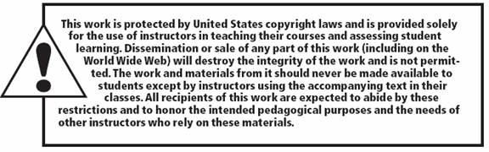
All rights reserved. No part of this publication may be reproduced, stored in a retrieval system, or transmitted, in any form or by any means, electronic, mechanical, photocopying, recording, or otherwise, without the prior written permission of the publisher. Printed in the United States of America.
Copyright © 2011 Pearson Education, Inc.
Publishing as Prentice Hall

